Slide 1
CSC 3210 Computer Organization and Programming
Chapter 4: Data Transfers,
Addressing, and Arithmetic
Dr. Zulkar Nine
mnine@gsu.edu
Georgia State University
Spring 2021

Slide 2
Outline
Data Transfer Instructions
Addition and Subtraction
Data-Related Operators and Directives
Indirect Addressing
JMP and LOOP Instructions

Slide 3
Data Transfer Instructions
Operand Types
Instruction Operand Notation
Direct Memory Operands
MOV Instruction
Zero & Sign Extension
XCHG Instruction
Direct-Offset Instructions

Slide 4
Data Transfer Instructions: Operand Types
Immediate – a constant integer (8, 16, or 32 bits)
value is encoded within the instruction
Register – the name of a register
register name is converted to a number and encoded within the instruction
Memory – reference to a location in memory
memory address is encoded within the instruction, or a register holds the address of a memory location
Listing File
00000000 .data
00000000 00000000 sum DWORD 0
00000000 .code
00000000 main proc
00000000 B8 00000008 mov eax, 8 00000005 83 C0 04 add eax, 4 00000008 A3 00000000 R mov sum, eax

Slide 5
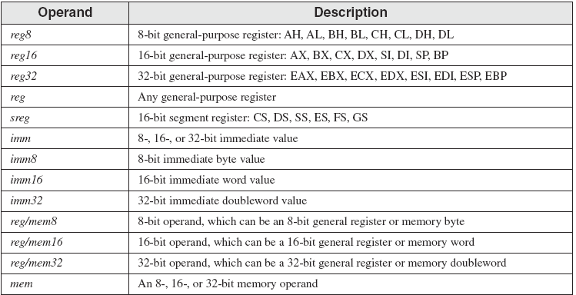
Data Transfer Instructions: Instruction Operand Notation
MOV reg,reg
MOV mem,reg
MOV reg,mem
MOV mem,imm
MOV reg,imm

Slide 6
Data Transfer Instructions
Register to Register
Register to Memory , Vice versa
0011010
0011012
0011014

Slide 7
How to see variables in VS

Slide 8
Data Transfer Instructions: Direct Memory Operands
A direct memory operand is a named reference to storage in memory
.data
var1 BYTE 10h
.code
mov al,var1 ; AL = 10h
mov al,[var1] ; AL = 10h
alternate format

Slide 9
Data Transfer Instructions: Direct Memory Operands
The named reference (label) is automatically dereferenced by the assembler
.data
var1 BYTE 10h
Suppose var1 were located at offset 10400h.
The following instruction copies its value into the AL register:
mov al, var1
It would be assembled into the following machine instruction:
A0 00010400

Slide 10
Data Transfer Instructions: Direct Memory Operands
The named reference (label) is automatically dereferenced by the assembler
A0 00010400
Listing File
00000000 .data
00000000 00000000 sum DWORD 0
00000000 .code
00000000 main proc
00000000 B8 00000008 mov eax, 8 00000005 83 C0 04 add eax, 4 00000008 A3 00000000 R mov sum, eax
- The first byte in the machine instruction is the opcode.
- The remaining part is the 32-bit hexadecimal address of var1.

Slide 11
Data Transfer Instructions: MOV Instruction
Move from source to destination.
Syntax:
MOV destination, source
Ex:
.data
count BYTE 100
wVal WORD 2
.code
mov bl,count
mov ax,wVal
mov count,al
mov al,wVal ; error
mov ax,count ; error
mov eax,count ; error
MOV instruction formats:
MOV reg,reg
MOV mem,reg
MOV reg,mem
MOV mem,imm
MOV reg,imm
Both operands must be the same size.
Both operands cannot be memory operands.
The (IP, EIP, or RIP) cannot be a destination operand.

Slide 12
Data Transfer Instructions: MOV Instruction
Explain why each of the following MOV statements are invalid:
.data
bVal BYTE 100
bVal2 BYTE ?
wVal WORD 2
dVal DWORD 5
.code
mov ds,45
mov eax,wVal
mov eip,dVal
mov 25,bVal
mov bVal2,bVal
immediate move to DS not permitted
size mismatch
Both operands must be the same size.
Both operands cannot be memory operands.
The (IP, EIP, or RIP) cannot be a destination operand.
EIP cannot be the destination
immediate value cannot be destination
memory-to-memory move not permitted

Slide 13
Data Transfer Instructions: MOV Instruction
Memory to Memory (problem):
A single MOV instruction cannot be used to move data directly from one memory location to another.
Instead, you must move
the source operand’s value to a register
before assigning its value to a memory operand:
.data
var1 WORD ?
var2 WORD ?
.code
mov ax,var1
mov var2,ax
Ex:
Notes:
Sec09 Feb14th

Slide 14
Data Transfer Instructions: MOV Instruction
Overlapping Values
The same 32-bit register can be modified using differently sized data.
When oneWord is moved to AX, it overwrites the existing value of AL.
When oneDword is moved to EAX, it overwrites AX.
When 0 is moved to AX, it overwrites the lower half of EAX.
.data
oneWord WORD 1234h
oneDword DWORD 12345678h
.code
mov eax, 0
mov ax, oneWord ; EAX = 00001234h
mov eax, oneDword ; EAX = 12345678h
mov ax, 0 ; EAX = 12340000h
Notes:
Sec 06, Feb 15

Slide 15
Data Transfer Instructions: Zero & Sign Extension
Sign extension problem:
MOV cannot directly copy data from a smaller operand to a larger one
Workarounds:
Suppose count (unsigned, 16 bits) must be moved to ECX (32 bits).
Trick: Set ECX to zero and move count to CX:
ecx
00000000000000000000000000000000
0000000000000001
ch
cx
cl
00000000000000000000000000000001
ecx
What happens if we try the same approach with a signed integer equal to -16?

Slide 16
ecx
00000000000000000000000000000000
0000000000000001
ch
cl
cx

Slide 17
Data Transfer Instructions: Zero & Sign Extension
Sign extension problem:
What happens if we try the same approach with a signed integer equal to -16?

Slide 19
Data Transfer Instructions: Zero & Sign Extension
Sign extension problem:
If we had filled ECX first with FFFFFFFFh and then copied signedVal to CX:
ecx
11111111111111111111111111111111
mov ecx,FFFFFFFFh
mov cx,signedVal ; ECX = FFFFFFF0h (-16)
1111111111110000
ch
cx
cl
MOVZX and MOVSX instructions to deal with both unsigned and signed integers.
11111111111111111111111111110000

Slide 20
Data Transfer Instructions: Zero Extension (MOVZX )
The MOVZX instruction
When you copy a smaller value into a larger destination,
the MOVZX instruction fills (extends) the upper half of the destination with zeros.
mov bl,10001111b
movzx ax,bl ; zero-extension
ah
ax
al
The destination must be a register.

Slide 22
Data Transfer Instructions: Zero Extension (MOVZX )

Slide 23
Data Transfer Instructions: Sign Extension (MOVSX )
The MOVSX instruction
It fills the upper half of the destination with a copy of the source operand's sign bit.
mov bl,10001111b
movsx ax,bl ; sign extension
ah
ax
al
The destination must be a register.

Slide 24
Data Transfer Instructions: Sign Extension (MOVSX )
In the following example,
the hexadecimal value moved to BX is A69B,
so the leading “A” digit tells us that the highest bit is set.
mov bx, A69Bh
movsx eax,bx ; EAX = FFFFA69Bh
movsx edx,bl ; EDX = FFFFFF9Bh
movsx cx,bl ; CX = FF9Bh
Notes:
TH, Sep-26, 4pm

Slide 25
Data Transfer Instructions: Zero & Sign Extension
MOVZX vs. MOVSX
MOVZX
MOVSX
ah
ax
al
ah
ax
al

Slide 27
Data Transfer Instructions: XCHG Instruction
XCHG exchanges the values of two operands.
At least one operand must be a register.
No immediate operands are permitted.
xchg ah,al ; exchange 8-bit regs
xchg ax,bx ; exchange 16-bit regs
xchg eax,ebx ; exchange 32-bit regs
xchg var1,bx ; exchange 16-bit mem op with BX
xchg var1,var2 ; error: two memory operands
Notes:
Sec 03, Fe16

Slide 29
Xchange items

Slide 30
Data Transfer Instructions: XCHG Instruction
XCHG exchanges the values of two operands.
At least one operand must be a register.
No immediate operands are permitted.
.data
var1 WORD 1000h
var2 WORD 2000h
.code
mov ax,val1
xchg ax,val2
mov val1,ax

Slide 31
Data Transfer Instructions: Direct-Offset Operands
A constant offset is added to a data label to produce an effective address (EA).
The address is dereferenced to get the value inside its memory location.
.data
arrayB BYTE 10h,20h,30h,40h
.code
mov al,arrayB ; AL = 10h
mov al,arrayB+1 ; AL = 20h
mov al,[arrayB+1] ; alternative notation
Why doesn't arrayB+1 produce 11h?
Notes:
Sec-09, Feb-18

Slide 32
Data Transfer Instructions: Direct-Offset Operands
.data
arrayW WORD 1000h,2000h,3000h
arrayD DWORD 1,2,3,4
.code
mov ax, [arrayW+2] ; AX = 2000h
mov ax, [arrayW+4] ; AX = 3000h
mov eax,[arrayD+4] ; EAX = 00000002h
Will the following statements assemble?
mov ax,[arrayW-2] ; ??
mov eax,[arrayD+16] ; ??

Slide 34
Data Transfer Instructions: Direct-Offset Operands
.data
arrayW WORD 1000h,2000h,3000h
arrayD DWORD 1,2,3,4
.code
mov ax, [arrayD+0] ; AX = 2000h
mov ax, [arrayD+4] ; AX = 3000h
mov eax,[arrayD+8] ; EAX = 00000002h
Will the following statements assemble?
mov ax,[arrayW-2] ; ??
mov eax,[arrayD+16] ; ??

Slide 36
Data Transfer Instructions: Direct-Offset Operands
Write a program that rearranges the values of three doubleword values in the following array as:
1,2,3 ----------→ 3, 1, 2.
.data
arrayD DWORD 1,2,3
LAB
Step1: copy the FIRST value into EAX and exchange it with the value in the SECOND position.
mov eax, arrayD
xchg eax, [arrayD+4]
Step 2: Exchange EAX with the THIRD array value and copy the value in EAX to the FIRST array position.
xchg eax,[arrayD+8]
mov arrayD,eax

Slide 38
Data Transfer Instructions: Direct-Offset Operands
We want to write a program that adds the following three bytes:
.data
myBytes BYTE 80h,66h,0A5h
What is your evaluation of the following code?
mov al,myBytes
add al,[myBytes+1]
add al,[myBytes+2]
What is your evaluation of the following code?
movsx ax, myBytes
add ax, [myBytes+1]
add ax, [myBytes+2]
Any other possibilities?

Slide 39
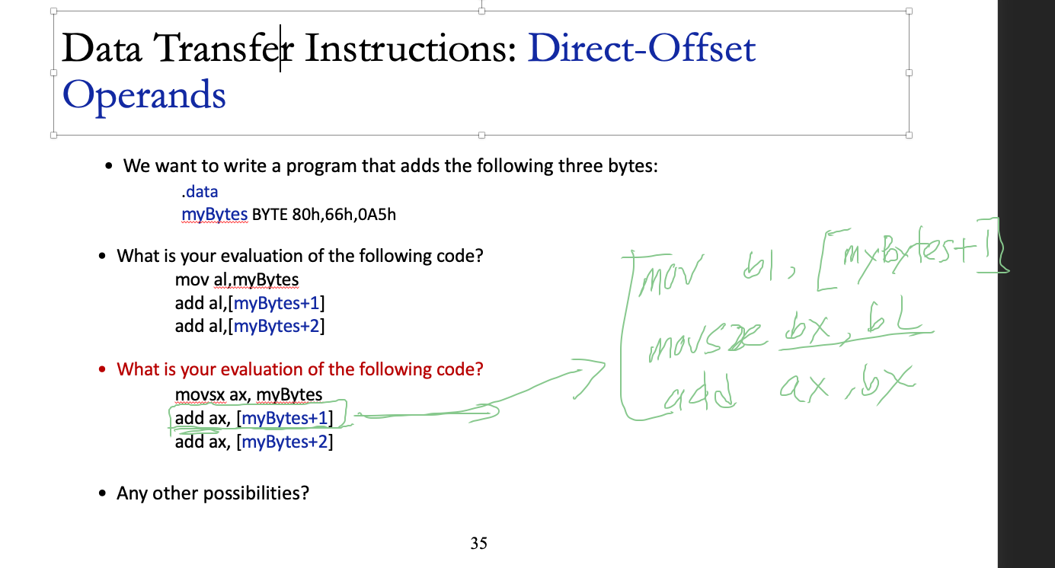

Slide 40
Outline
Data Transfer Instructions
Addition and Subtraction
Data-Related Operators and Directives
Indirect Addressing
JMP and LOOP Instructions

Slide 41
Addition and Subtraction
INC and DEC Instructions
ADD and SUB Instructions
NEG Instruction
Implementing Arithmetic Expressions
Flags Affected by Arithmetic
Zero
Sign
Carry
Overflow

Slide 42
Addition and Subtraction: INC and DEC Instructions
Add 1, subtract 1 from destination operand
operand may be register or memory
The Syntax:
INC destination
Logic: destination ← destination + 1
DEC destination
Logic: destination ← destination – 1

Slide 43
Addition and Subtraction: INC and DEC Examples
.data
myWord WORD 1000h
myDword DWORD 10000000h
.code
inc myWord ; 1001h
dec myWord ; 1000h
inc myDword ; 10000001h
mov ax,00FFh
inc ax ; AX = 0100h
mov ax,00FFh
inc al ; AX = 0000h

Slide 44
Addition and Subtraction: INC and DEC Examples
Show the value of the destination operand after each of the following instructions executes:
.data
myByte BYTE FFh, 0
.code
mov al,myByte ; AL =
mov ah,[myByte+1] ; AH =
dec ah ; AH =
inc al ; AL =
dec ax ; AX =
FFh
00h
FFh
00h
FEFF

Slide 45
Addition and Subtraction
INC and DEC Instructions
ADD and SUB Instructions
NEG Instruction
Implementing Arithmetic Expressions
Flags Affected by Arithmetic
Zero
Sign
Carry
Overflow

Slide 46
ADD and SUB Instructions
ADD destination, source
Logic: destination ← destination + source
SUB destination, source
Logic: destination ← destination – source
Same operand rules as for the MOV instruction

Slide 47
ADD and SUB Examples
.data
var1 DWORD 10000h
var2 DWORD 20000h
.code ; ---EAX---
mov eax,var1 ; 00010000h
add eax,var2 ; 00030000h
add ax,0FFFFh ; 0003FFFFh
add eax,1 ; 00040000h
sub ax,1 ; 0004FFFFh
Can you add registers of different sizes?
add eax,bx
Can you add mem to mem?
add var1,var2
Notes:
Sep27,Wed, 3pm

Slide 48
Addition and Subtraction
INC and DEC Instructions
ADD and SUB Instructions
NEG Instruction
Implementing Arithmetic Expressions
Flags Affected by Arithmetic
Zero
Sign
Carry
Overflow
Notes:
Sec09, Feb21
Sum 2017. Jun 22nd

Slide 49
NEG (negate) Instruction
Reverses the sign of an operand.
Operand can be a register or memory operand.
Ex.
.data
valB SBYTE -1 ;valB BYTE -1 is also acceptable, why?
valW WORD +32
.code
mov al,valB ; AL = -1
neg al ; AL = +1
neg valW ; valW = -32
Suppose AX contains –32,768 and we apply NEG to it.
Will the result be valid?
Notes:
Sep28, Thr, 9:30
Sec06, Feb27

Slide 50
Addition and Subtraction
INC and DEC Instructions
ADD and SUB Instructions
NEG Instruction
Implementing Arithmetic Expressions
Flags Affected by Arithmetic
Zero
Sign
Carry
Overflow
Notes:
Sec03, Feb 21

Slide 51
Implementing Arithmetic Expressions
HLL compilers translate mathematical expressions into assembly language.
You can do it also.
For example: Do not permit Xval, Yval, or Zval to be modified
Rval = -Xval + (Yval – Zval)
.code
mov eax,Xval
neg eax ; EAX = -26
mov ebx,Yval
sub ebx,Zval ; EBX = -10
add eax,ebx
mov Rval,eax ; -36
.data
Rval SDWORD ?
Xval SDWORD 26
Yval SDWORD 30
Zval SDWORD 40

Slide 52
Implementing Arithmetic Expressions
Translate the following expression into assembly language.
Do not permit Xval, Yval, or Zval to be modified:
Rval = Xval - (-Yval + Zval)
Previous Example:
Rval = -Xval + (Yval – Zval)
Assume that all values are signed doublewords.
mov ebx,Yval
neg ebx
add ebx,Zval
mov eax,Xval
sub eax,ebx
mov Rval,eax
.data
Rval SDWORD ?
Xval SDWORD 26
Yval SDWORD 30
Zval SDWORD 40

Slide 53
Addition and Subtraction
INC and DEC Instructions
ADD and SUB Instructions
NEG Instruction
Implementing Arithmetic Expressions
Flags Affected by Arithmetic
Zero
Sign
Carry
Overflow

Slide 54
Flags: Why?
When executing arithmetic instructions, we often want to know something about the result:
Is it negative, positive, or zero?
Is it too large or too small to fit into the destination operand?
Answers to such questions can help detect calculation errors that might otherwise cause erratic program behavior.
The values of CPU status flags is used to check the outcome of arithmetic operations.
Status flag values are also used to activate conditional branching instructions, the basic tools of program logic.

Slide 55
Flags: Flags Affected by Arithmetic/Bitwise
The ALU has a number of status flags that reflect the outcome of
arithmetic operations
bitwise operations
based on the contents of the
destination operand

Slide 56
Flags: Flags Affected by Arithmetic/Bitwise
Essential flags:
Zero flag – set when destination equals zero
Sign flag – set when destination is negative
Carry flag – set when unsigned value is out of range
Overflow flag – set when signed value is out of range
Visual Studio Flags?
The MOV instruction never affects the flags. (Why?)

Slide 57
Flags: Map
The ALU has a number of status flags that reflect the outcome of arithmetic operations and bitwise operations.
CPU
part of
executes
executes
ALU
conditional jumps
arithmetic & bitwise operations
attached to
used by
affect
provide
status flags
branching logic

Slide 58
Flags: Displaying CPU Flags in Visual Studio
You must be currently debugging a program in order to see these menu options.
To display the CPU status flags during a debugging session,
select Windows from the Debug menu,
then select Registers from the Windows menu.
Inside the Registers window, right-click and select Flags from the dropdown list.
Each flag is assigned a value of 0 (clear) or 1 (set).

Slide 59
Flags: Unsigned and Signed Integers Operations
All CPU instructions operate exactly the same on signed and unsigned integers
The CPU cannot distinguish between signed and unsigned integers
The programmer, are responsible for using the correct data type with each instruction
CF vs. OF

Slide 60
Flags: Unsigned Operations, Zero flag (ZF)
The Zero flag (ZF) is set when the result of an operation produces zero in the destination operand.
Based on the contents of the destination operand
mov ecx,1
sub ecx,1 ; ECX = 0, ZF = 1
mov eax,FFFFFFFFh
inc eax ; EAX = 0, ZF = 1
inc eax ; EAX = 1, ZF = 0
Remember...
A flag is set when it equals 1.
A flag is clear when it equals 0.
Notes:
Jun.27th, Tuesday

Slide 61
Flags: Unsigned Operations, Carry flag (CF)
The Carry flag (CF) is set when the result of an operation generates an unsigned value that is out of range (too big or too small for the destination operand).
Addition .Vs Subtraction (borrow)
Addition and the Carry Flag
mov al,0FFh
add al,1 ; CF = 1, AL = 00
Notes:
For integer class numbers, "underflow" is said to occur when the value would be less than the minimum integer representable in that class.

Slide 62
Flags: Unsigned Operations, Carry flag (CF)
Subtraction and the Carry (and borrow) Flag
A subtract operation sets the Carry flag when
a larger unsigned integer is subtracted from a smaller one.
mov al,1
sub al,2 ; AL = FFh, CF = 1
Notes:
For integer class numbers, "underflow" is said to occur when the value would be less than the minimum integer representable in that class.

Slide 63
Flags: Unsigned Operations, Carry flag (CF)
Subtraction and the Carry (and borrow) Flag
A subtract operation sets the Carry flag when
a larger unsigned integer is subtracted from a smaller one.
; Try to go below zero:
mov al,0
sub al,1 ; CF = 1, AL = FF
Notes:
For integer class numbers, "underflow" is said to occur when the value would be less than the minimum integer representable in that class.

Slide 64
Flags: Unsigned Operations, Parity
Parity
The Parity flag (PF) is set when
The least significant byte of the destination has an even number of 1 bits.
The following ADD and SUB instructions alter the parity of AL:
mov al,10001100b
add al,00000010b ; AL = 10001110, PF = 1
sub al,10000000b ; AL = 00001110, PF = 0

Slide 65
Flags: Signed Operations, Sign Flag (SF)
The Sign flag (SF) is set when the destination operand is negative.
The flag is clear when the destination is positive.
mov cx,0
sub cx,1 ; CX = -1, SF = 1
add cx,2 ; CX = 1, SF = 0

Slide 66
Flags: Signed Operations, Sign Flag (SF)
The Sign flag (SF) is set when the destination operand is negative.
The sign flag is a copy of the destination's highest bit:
mov al,0
sub al,1 ; AL = 11111111b, SF = 1
add al,2 ; AL = 00000001b, SF = 0

Slide 67
Flags: Signed Operations, Overflow Flag (OF)
The Overflow flag (OF) is set when the signed result of an operation is invalid or out of range.
; Example 1
mov al,+127
add al,1 ; OF = 1, AL = ??
; Example 2
mov al,7Fh ; OF = 1, AL = 80h
add al,1
The two examples are identical at the binary level because 7Fh equals +127.
To determine the value of the destination operand, it is often easier to calculate in hexadecimal.
Notes:
AL = 80

Slide 68
Flags: Unsigned and Signed Integers Operations
For each of the following marked entries,
show the values of the destination operand and the Sign, Zero, Carry , and overflow flags:
mov ax,7ff0h
add al,10h ; AX= SF= ZF= CF= OF=
add ah,1 ; AX= SF= ZF= CF= OF=
add ax,2 ; AL= SF= ZF= CF= OF=
8000 → 32768

Slide 69
Flags: Unsigned and Signed Integers Operations
Use the following data for Questions 4-5:
.data
val2 WORD 8000h
val4 WORD 7FFFh
1. If val2 is incremented by 1 using the ADD instruction, what will be the values of the Carry and Sign flags?
2. If val4 is incremented by 1 using the ADD instruction, what will be the values of the Overflow and Sign flags?

Slide 70
Flags: Unsigned and Signed Integers Operations
A Rule of Thumb
When adding two integers, remember that the Overflow flag is only set when . . .
Two positive operands are added and their sum is negative
Two negative operands are added and their sum is positive
What will be the values of the Overflow flag?
mov al,80h
add al,92h ; OF =
mov al,-2
add al,+127 ; OF =
1
0
Notes:
Two positive operands are added and their sum is negative
mov al,+127 add al,1 ; OF = 1, AL = ??
Overflow occurs if
(+A) + (+B) = −C
(−A) + (−B) = +C
Example: Using 4-bit Two's Complement numbers (−8 ≤ x ≤ +7)
(−7) 1001
+(−6) 1010
------------
(−13) 1 0011 = 3 : Overflow (largest −ve number is −8)

Slide 71
Flags: Unsigned and Signed Integers Operations
Overflow and Carry Flags
What will be the values of the given flags after each operation?
mov al,-128
neg al ; CF = OF =
mov ax,8000h
add ax,2 ; CF = OF =
mov ax,0
sub ax,2 ; CF = OF =
mov al,-5
sub al,+125 ; OF =
1 1
0 0
1 0
1
a larger signed integer is subtracted from a smaller one
?
Notes:
A subtract operation sets the Carry flag when
a larger signed integer is subtracted from a smaller one.

Slide 72
Flags: NEG Instruction
The NEG instruction produces an invalid result
If the destination operand cannot be stored correctly.
Ex1.
- If we move 128 to AL and try to negate it, the correct value (128) will not fit into AL.
- The Overflow flag is set, indicating that AL contains an invalid value:
mov al,-128 ; AL = 10000000b
neg al ; AL = 10000000b, OF = 1

Slide 73
Flags: NEG Instruction
The NEG instruction produces an invalid result
If the destination operand cannot be stored correctly.
Ex2.
- If 127 is negated, the result is valid and the Overflow flag is clear:
mov al,+127 ; AL = 01111111b
neg al ; AL = 10000001b, OF = 0

Slide 74
Flags: NEG Instruction
The NEG instruction produces an invalid result
If the destination operand cannot be stored correctly.
Ex2.
- If 127 is negated, the result is valid and the Overflow flag is clear:
mov al,+127 ; AL = 01111111b
neg al ; AL = 10000001b, OF = 0

Slide 75
Outline
Data Transfer Instructions
Addition and Subtraction
Data-Related Operators and Directives
Indirect Addressing
JMP and LOOP Instructions
64-Bit Programming

Slide 76
Operators and Directives
Operators and directives are not executable instructions;
They are interpreted by the assembler.
OFFSET Operator
PTR Operator
TYPE Operator
LENGTHOF Operator
SIZEOF Operator

Slide 77
OFFSET Operator
OFFSET returns the offset of the data label, it represents the distance in bytes, of a label from the beginning of its enclosing segment
Protected mode: 32 bits
Real mode: 16 bits
The Protected-mode programs we use only a single segment (flat memory model).

Slide 78
OFFSET: Examples
Let's assume that the data segment begins at 00404000h:
.data
bVal BYTE ?
wVal WORD ?
dVal DWORD ?
dVal2 DWORD ?
.code
mov esi,OFFSET bVal ; ESI = 00404000
mov esi,OFFSET wVal ; ESI = 00404001
mov esi,OFFSET dVal ; ESI = 00404003
mov esi,OFFSET dVal2 ; ESI = 00404007
1 Byte
2 Bytes
4 Bytes
data segment
bVal
wVal
dVal
…..
00404000h
This is a memory address
not a memory value
Notes:
Sec06, Mar01

Slide 79
OFFSET: Examples
OFFSET can also be applied to a direct-offset operand
Suppose myArray contains five 16-bit words
The following MOV instruction
Obtains the offset of myArray,
Adds 4,
Moves the resulting address to ESI.
We can say that ESI points to the third integer in the array:
.data
myArray WORD 1,2,3,4,5
.code
mov esi,OFFSET myArray + 4
ESI = 00404000 + 4
Notes:
Sep28,TH 4pm
Sec03, 09 Mar 2

Slide 80
OFFSET: Relating to C/C++
The value returned by OFFSET is a pointer.
Compare the following code written for both C++ and assembly language:
; Assembly language:
.data
array BYTE 1000 DUP(?)
.code
mov esi,OFFSET array
// C++ version:
char array[1000];
char * p = array;

Slide 81
PTR Operator
Overrides the default type of a label (variable).
Provides the flexibility to access PART of a variable.
Used in combination with BYTE, SBYTE, WORD, SWORD, DWORD, SDWORD, FWORD, QWORD, or TBYTE
Ex. PTR operator makes it possible to move the low-order
But the WORD PTR operator makes it possible to move the low-order word (5678h) to AX:
Why wasn’t 1234h moved into AX?

Slide 82
PTR Operator
Why wasn’t 1234h moved into AX?
x86 processors use the little endian storage format
low-order byte is stored at the variable’s starting address
For example, the doubleword 12345678h would be stored as:
When integers are loaded from memory into registers, the bytes are automatically re-reversed into their correct positions
(5678h)

Slide 83
PTR Operator: Example1
.data
myDouble DWORD 12345678h
Memory Layout
mov al,BYTE PTR myDouble ; AL = 78h
mov al,BYTE PTR [myDouble+1] ; AL = 56h
mov al,BYTE PTR [myDouble+2] ; AL = 34h
mov ax,WORD PTR myDouble ; AX = 5678h
mov ax,WORD PTR [myDouble+2] ; AX = 1234h

Slide 84
PTR Operator: Example2
PTR can also be used to combine elements of a smaller data type and move them into a larger operand.
.data
wordList WORD 5678h,1234h
.code
mov eax, DWORD PTR wordList
; EAX = 12345678h

Slide 85
PTR Operator: Exercise
Use the following data definitions for Questions 6:
myBytes BYTE 10h,20h,30h,40h
myWords WORD 8Ah,3Bh,72h,44h,66h
myDoubles DWORD 1,2,3,4,5
myPointer DWORD myDoubles

Slide 86
TYPE Operator
The TYPE operator returns the size, in bytes, of a single element of a data declaration.
.data
var1 BYTE ?
var2 WORD ?
var3 DWORD ?
var4 QWORD ?
.code
mov eax,TYPE var1 ; 1
mov eax,TYPE var2 ; 2
mov eax,TYPE var3 ; 4
mov eax,TYPE var4 ; 8

Slide 87
LENGTHOF Operator
The LENGTHOF operator counts the number of elements in a single data declaration.
.data LENGTHOF
byte1 BYTE 10,20,30 ; 3
array1 WORD 30 DUP(?),0,0 ; 32
array2 WORD 5 DUP(3 DUP(?)) ; 15
array3 DWORD 1,2,3,4 ; 4
digitStr BYTE "12345678",0 ; 9
.code
mov ecx,LENGTHOF array1 ; 32

Slide 88
SIZEOF Operator
The SIZEOF operator returns a value that is equivalent to multiplying LENGTHOF by TYPE.
.data SIZEOF
byte1 BYTE 10,20,30 ; 3
array1 WORD 30 DUP(?),0,0 ; 64
array2 WORD 5 DUP(3 DUP(?)) ; 30
array3 DWORD 1,2,3,4 ; 16
digitStr BYTE "12345678",0 ; 9
.code
mov ecx,SIZEOF array1 ; 64

Slide 89
Outline
Data Transfer Instructions
Addition and Subtraction
Data-Related Operators and Directives
Indirect Addressing
JMP and LOOP Instructions
Notes:
Jun.29th, Summer2017

Slide 90
Indirect Addressing
Indirect Operands
Array Sum Example
Indexed Operands
Pointers
Notes:
Mon 3pm, Oct 2,2017
TU 9:30, Oct 3

Slide 91
Indirect Addressing (1)
Direct addressing becomes infeasible for array access.
Mov eax, arrayD
Mov eax, [arrayD+4]
Mov eax, [arrayD+8]
There is no way to parameterize the constant offset (e.g. 4)

Slide 92
Indirect Addressing (2)
Indirect addressing can solve the issue
Consider the example.
.data
Val1 BYTE 11h, 33h, 55h
Store the address of the array in any 32-bit register.
mov esi, OFFSET val1
The put that register inside the bracket to dereference it.
mov al, [esi]
Now Al contains 11h

Slide 93

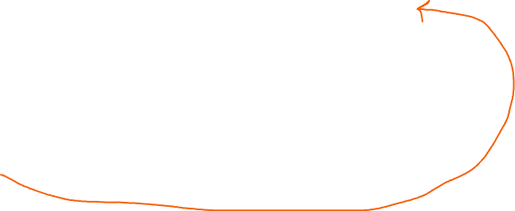
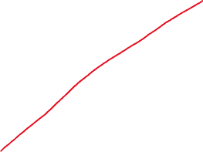

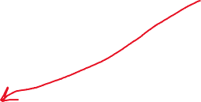
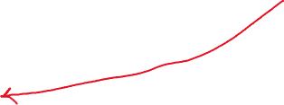
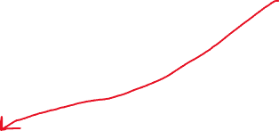

Indirect Addressing
Main memory
.data
arrayW WORD 1122h, 3344h, 5566h
40440000
22
mov esi,OFFSET arrayW
40440001
11
40440002
44
4044000
40440003
33
ESI
40440004
66
mov ax, [esi]
40440005
55
add esi, 2
mov ax, [esi]
33
22
11
44
AX
4044000+2 = 4044002

Slide 94
Attendance!

Slide 95
Indirect Addressing: Indirect Operands
An indirect operand holds the address of a variable, usually an array or string.
It can be dereferenced (just like a pointer).
.data
val1 BYTE 10h,20h,30h
.code
mov esi,OFFSET val1
mov al,[esi] ; dereference ESI (AL = 10h)
inc esi
mov al,[esi] ; AL = 20h
inc esi
mov al,[esi] ; AL = 30h
🤔

Slide 96
Indirect Addressing: Indirect Operands
Use PTR to clarify the size attribute of a memory operand.
.data
myCount WORD 7,3,2
.code
mov esi,OFFSET myCount
inc [esi] ; error: ambiguous
inc WORD PTR [esi] ; ok
The size of an operand may not be evident from the context of an instruction.

Slide 97
Indirect Addressing: Array Sum Example
Indirect operands are ideal for traversing an array.
Note that the register in brackets must be incremented by a value that matches the array type.
.data
arrayW WORD 1000h,2000h,3000h
.code
mov esi,OFFSET arrayW
mov ax,[esi]
add esi,2 ; or: add esi,TYPE arrayW
add ax,[esi]
add esi,2
add ax,[esi] ; AX = sum of the array
ToDo: Modify this example for an array of doublewords.

Slide 98
Indirect Addressing
Indirect Operands
Array Sum Example
Indexed Operands
Pointers

Slide 99
Indexed Operands
Instead of storing the address in ESI register (or any 32-bit register)
You can use these registers as counter.
An indexed operand adds a constant to a register to generate an effective address.
There are two notational forms:
[label + reg] label[reg]
[var1 + esi] OR var1[esi]

Slide 100
Indexed Operands
An indexed operand adds a constant to a register to generate an effective address.
There are two notational forms:
[label + reg] label[reg]
.data
arrayW WORD 1000h,2000h,3000h
.code
mov esi,0
mov ax,[arrayW + esi] ; AX = 1000h
mov ax,arrayW[esi] ; alternate format
add esi,2
add ax,[arrayW + esi]
etc.
ToDo: Modify this example for an array of doublewords.

Slide 101
Indirect Addressing
Indirect Operands
Array Sum Example
Indexed Operands
Pointers

Slide 102
Pointers
You can declare a pointer variable that contains the offset of another variable.
.data
arrayW WORD 1000h,2000h,3000h
myptrW arrayW
.code
mov esi,myptrW
mov ax,[esi] ; AX = 1000h
DWORD
Alternate format:
myptrW DWORD OFFSET arrayW

Slide 103
Outline
Data Transfer Instructions
Addition and Subtraction
Data-Related Operators and Directives
Indirect Addressing
JMP and LOOP Instructions
Notes:
Sec06, Mar6
Sec03, Mar7
Sec03, Mar9

Slide 104
JMP and LOOP Instructions
JMP Instruction
LOOP Instruction
LOOP Example
Summing an Integer Array
Copying a String

Slide 105
JMP and LOOP Instructions
CPU loads and executes programs sequentially
Current instruction might be a one that transfer control to a different memory address
Assembly language programs use conditional instructions to implement high-level statements
IF statements and Loops.
offset machine code source code
00000000 B8 00000000 mov eax,0 00000005 EB 03 jmp addone 00000007 83 C0 02 add eax,2
0000000A addone: 0000000A 40 inc eax
0000000B 83 C0 01 add eax,4294967295

Slide 106
JMP and LOOP Instructions
There are two basic types of transfers:
Unconditional Transfer
Conditional Transfer
Unconditional Transfer: Control is transferred to a new location in all cases
New address is loaded into the instruction pointer, EIP,
causing execution to continue at the new address.
The JMP instruction does this.

Slide 107
JMP Instruction (Unconditional Transfer)
JMP is an unconditional jump to a label that is usually within the same procedure.
Syntax: JMP target
Logic: EIP ← target
offset machine code source code
00000005 EB 03 jmp addone 00000007 83 C0 02 add eax,2
0000000A addone: 0000000A 40 inc eax
EIP=
EIP=

Slide 108
JMP Instruction (Unconditional Transfer)
JMP is an unconditional jump to a label that is usually within the same procedure.
Example:
mov eax,0
Jmp addone
add eax,2
addone:
inc eax
add eax, 4294967295 ;2^32 = 4294967296
A jump outside the current procedure must be to a special type of label called a global label (see Section 5.5.2.3 for details).
Try Visual Studio

Slide 109
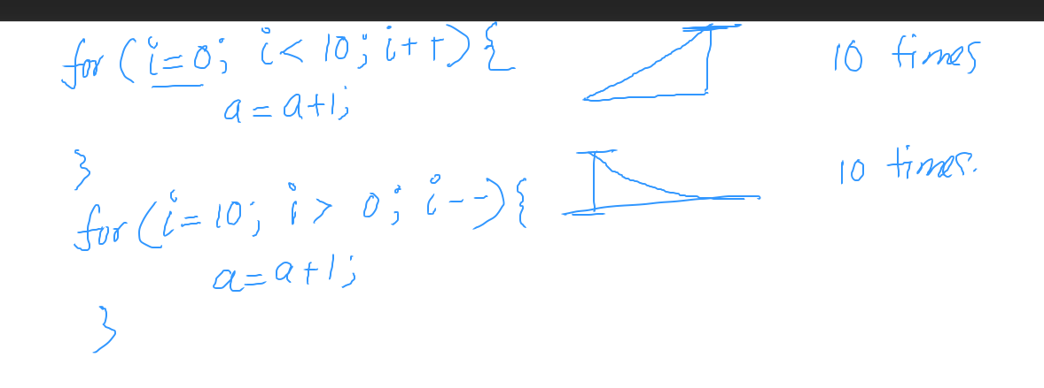

Slide 110
LOOP Instruction (Conditional Transfer)
Conditional Transfer: The program branches if a certain condition is true
A wide variety of conditional transfer instructions can be combined to create conditional logic structures.
The LOOP instruction creates a counting loop
Syntax: LOOP target
Logic:
ECX ← ECX – 1
if ECX != 0, jump to target
The CPU interprets true/false conditions based on
the contents of the ECX and Flags registers.

Slide 111
LOOP: Example
The following loop calculates the sum of the integers 5 + 4 + 3 +2 + 1:
mov ax,0
mov ecx,5
L1: add ax,cx
loop L1
Logic: ECX ← ECX – 1
if ECX != 0, jump to target
offset machine code source code
00000000 66 B8 0000 mov ax,0
00000004 B9 00000005 mov ecx,5
00000009 66 03 C1 L1: add ax,cx
0000000C E2 FB loop L1
0000000E
How assembler calculates FB?
Notes:
Tu, Oct 3,2017, 4pm

Slide 113
LOOP: Example (Conditional Transfer)
The assembler calculates the distance, in bytes, between
the offset of the following instruction and
the offset of the target label.
offset machine code source code
00000009 66 03 C1 L1: add ax,cx
0000000C E2 FB loop L1
0000000E

Slide 114
LOOP: Example (Conditional Transfer)
When LOOP is assembled,
The current location = 0000000E (offset of the next instruction)
Distance is
-5 (FBh)
FBh is added to the the current location,
causing a jump to location 00000009:
Target Label location address = Offset of the next instruction + Distance
00000009 ← 0000000E + FB
The relative offset is added to EIP = 00000009

Slide 115
LOOP: Example
If the relative offset is encoded in a single signed byte,
(a) what is the largest possible backward jump?
(b) what is the largest possible forward jump?
−128
+127

Slide 116
LOOP: Example
mov ax,6
mov ecx,4
L1:
inc ax
loop L1
What will be the final value of AX?
10
How many times will the loop execute?
mov ecx,0
X2:
inc ax
loop X2
A common programming error is to inadvertently initialize ECX to zero before beginning a loop.

Slide 117
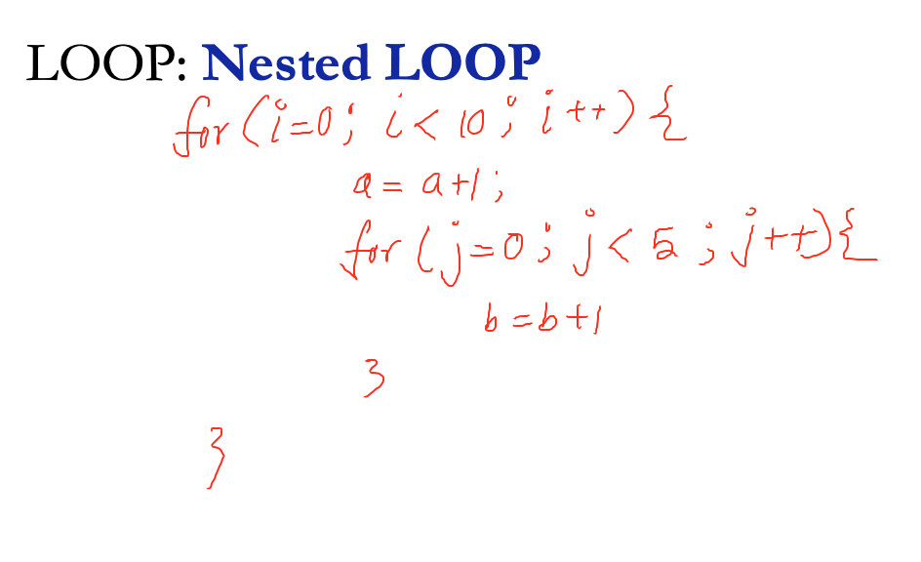
LOOP: Nested LOOP

Slide 118
LOOP: Nested LOOP
If you need to code a loop within a loop, you must save the outer loop counter's ECX value.
In the following example, the outer loop executes 3 times, and the inner loop 2 times.
.data
count DWORD ?
.code
mov ecx,3 ; set outer loop count
L1:
mov count,ecx ; save outer loop count
mov ecx,2 ; set inner loop count
L2: .
.
loop L2 ; repeat the inner loop
mov ecx,count ; restore outer loop count
loop L1 ; repeat the outer loop

Slide 119
JMP and LOOP Instructions
JMP Instruction
LOOP Instruction
LOOP Example
Summing an Integer Array
Copying a String

Slide 120
Array: Summing an Integer Array
The following code calculates the sum of an array of 16-bit integers.
1. Assign the array’s address to a register that will serve as an indexed operand.
2. Initialize the loop counter to the length of the array.
3. Assign zero to the register that accumulates the sum.
4. Create a label to mark the beginning of the loop.
5. In the loop body, add a single array element to the sum.
6. Point to the next array element.
7. Use a LOOP instruction to repeat the loop.
.data
intarray WORD 100h,200h,300h,400h
.code
mov edi,OFFSET intarray ; address of intarray
mov ecx,LENGTHOF intarray ; loop counter
mov ax,0 ; zero the accumulator
L1:
add ax,[edi] ; add an integer
add edi,TYPE intarray ; point to next integer
loop L1 ; repeat until ECX = 0
1
2
3
4
5
6
7
Notes:
The SIZEOF operator returns a value that is equivalent to multiplying LENGTHOF by TYPE.

Slide 121
Array: Summing an Integer Array
What changes would you make to the program on the previous slide if you were summing a doubleword array?
intarray WORD 100h,200h,300h,400h
mov ax,0
add ax,[edi]

Slide 122
JMP and LOOP Instructions
JMP Instruction
LOOP Instruction
LOOP Example
Summing an Integer Array
Copying a String

Slide 123
Copying a String
Use a loop to copy a string, represented as an array of bytes with a null terminator value.
source BYTE "This is the source string",0
The target string must have enough available space to receive the copied characters, including the null byte at the end 🤔:
The SIZEOF operator returns a value that is equivalent to multiplying LENGTHOF by TYPE.
target BYTE SIZEOF source DUP(0)
Indexed addressing works well for this type of operation because the same index register references both strings.
mov esi,0 ; index register
mov al,source[esi] ; get char from source
mov target[esi],al
Notes:
The SIZEOF operator returns a value that is equivalent to multiplying LENGTHOF by TYPE.
26

Slide 124
Copying a String
The following code copies a string from source to target:
.data
source BYTE "This is the source string",0
target BYTE SIZEOF source DUP(0)
.code
mov esi,0 ; index register
mov ecx,SIZEOF source ; loop counter
L1:
mov al,source[esi] ; get char from source
mov target[esi],al ; store it in the target
inc esi ; move to next character
loop L1 ; repeat for entire string
good use of SIZEOF

Slide 126
Copying a String
Rewrite the program shown in the previous slide, using indirect addressing rather than indexed addressing.

Slide 127
Summary
Data Transfer
MOV – data transfer from source to destination
MOVSX, MOVZX, XCHG
Operand types
direct, direct-offset, indirect, indexed
Arithmetic
INC, DEC, ADD, SUB, NEG
Sign, Carry, Zero, Overflow flags
Operators
OFFSET, PTR, TYPE, LENGTHOF, SIZEOF, TYPEDEF
JMP and LOOP – branching instructions

